Slide 1

DEPARTMENT OF ELECTRONICS AND COMMUNICATION ENGINEERING
INTERNSHIP PRESENTATION
ON
“FINAL INSPECTION OF CATREDGE”
CARRIED OUT AT: STANLEY ENGINEERED FASTENING PVT. LTD.
Under the guidance of:
Dr. Praveen Reddy
Presented by:
MOHD AFTAB AHMED
(3GN21EC043)

Slide 2

INDEX
INTRODUCTION
OBJECTIVE OF THE INTERNSHIP
COMPANY OVERVIEW
INSPECTION PROCESS OVERVIEW
FINAL INSPECTION PROCEDURE
TOOLS
SAFETY AND EQUIPMENT USED
QUALITY CONTROL PARAMETERS
CHALLENGES FACED
LEARNINGS AND SKILLS GAINED
CONCLUSION

Slide 3
INTRODUCTION
Stanley Engineered Fastening, a division of Stanley Black & Decker, is a trusted global supplier of precision fastening and assembly solutions. In the medical sector, the company plays a vital role in supporting the assembly of critical components such as cartridges used in diagnostic and drug delivery devices. This internship focuses on learning the importance of Quality Assurance & Quality Control especially during the final inspection process. Maintaining high standards ensures product reliability, patient safety, and upholds the company’s strong reputation in the healthcare industry.

Slide 4
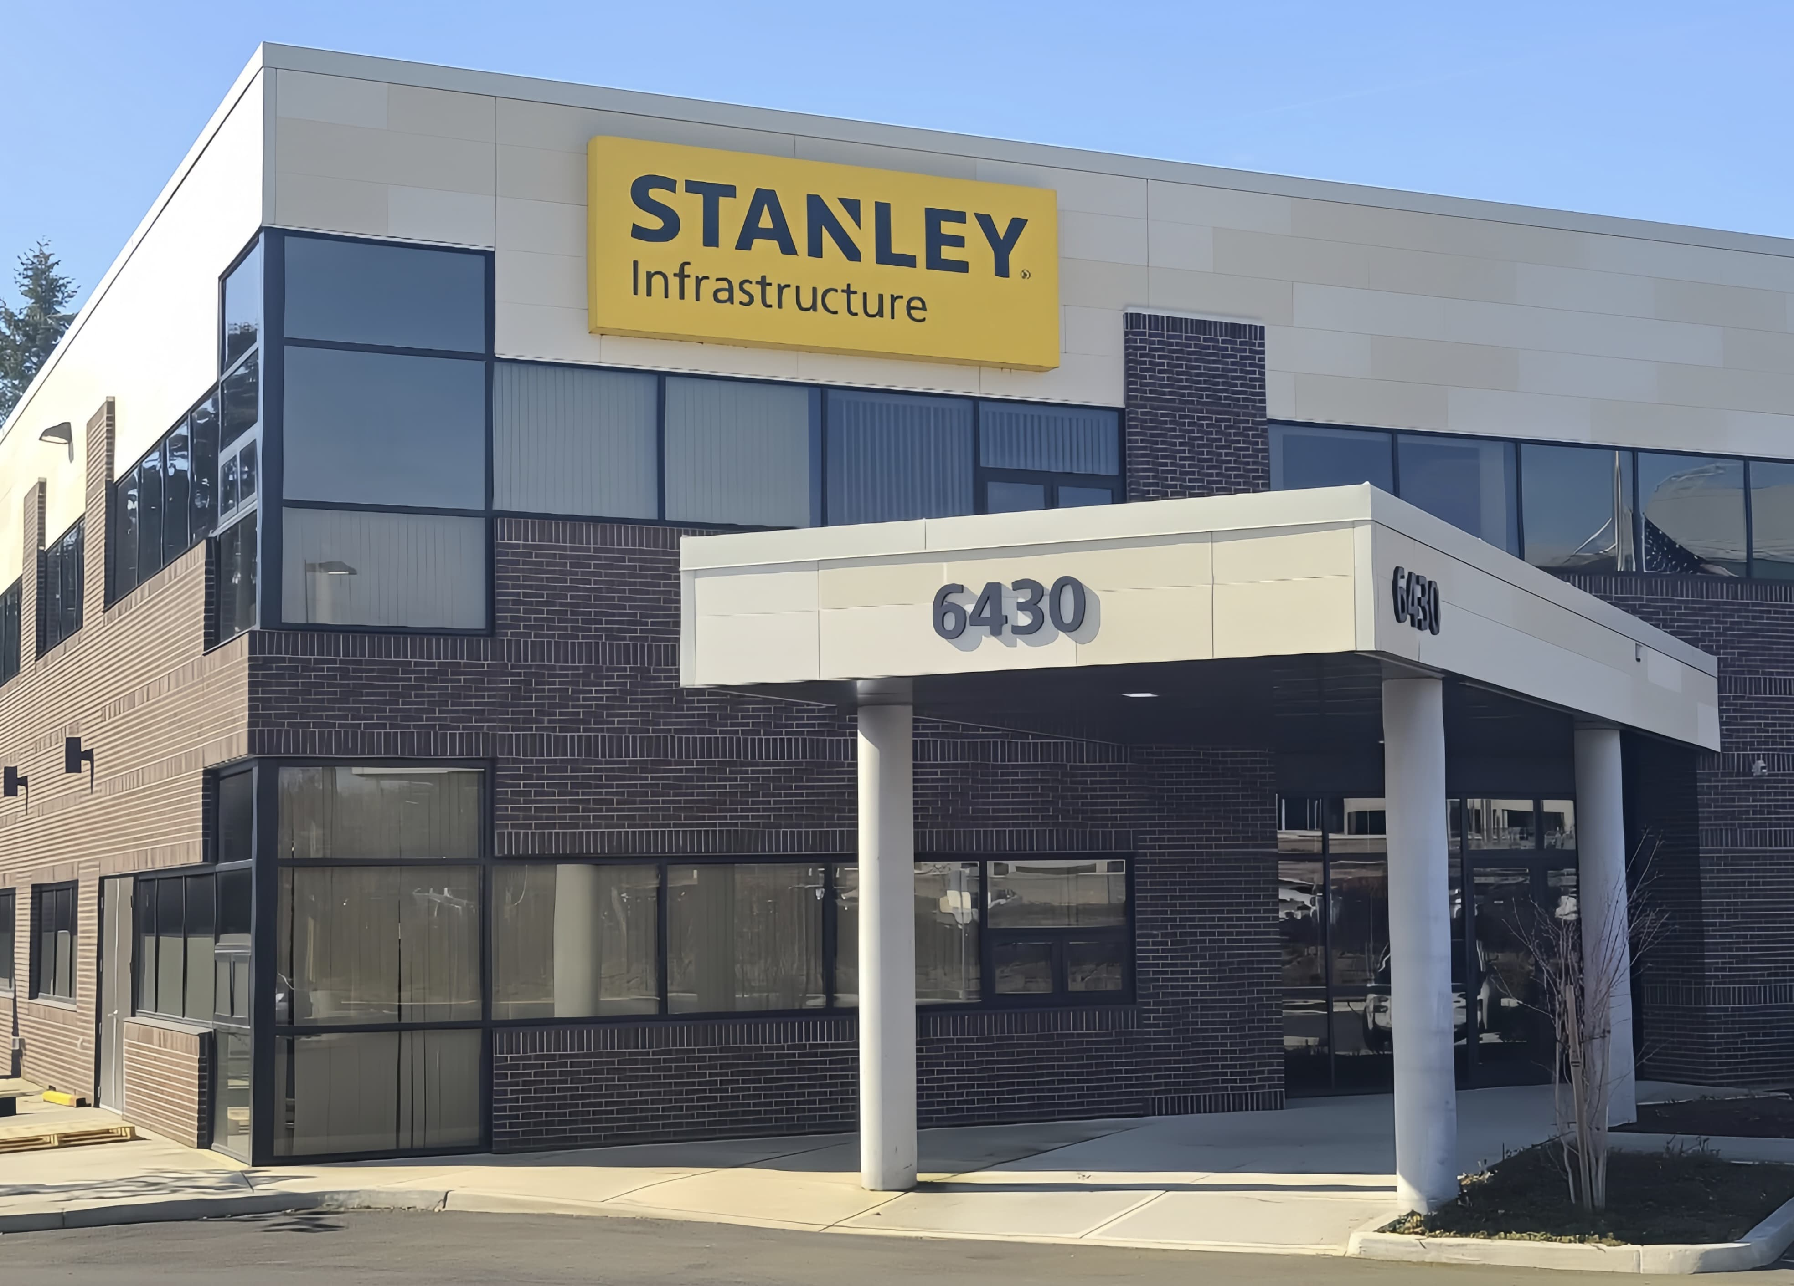
Company Overview
Stanley Engineered Fastening, a division of Stanley Black & Decker, delivers high-performance fasteners and cartridges. Known for innovation, precision, and safety, their products are essential in industrial, construction, and medical applications where reliable fastening is critical.

Slide 5
OBJECTIVES OF THE INTERNSHIP
The key goals of this internship include:
Learning the detailed process involved in final inspection.
Understanding industry-level quality standards.
Contributing to real-time quality assurance tasks.
Gaining hands-on experience in an industrial environment with a focus on cartridge production.

Slide 6
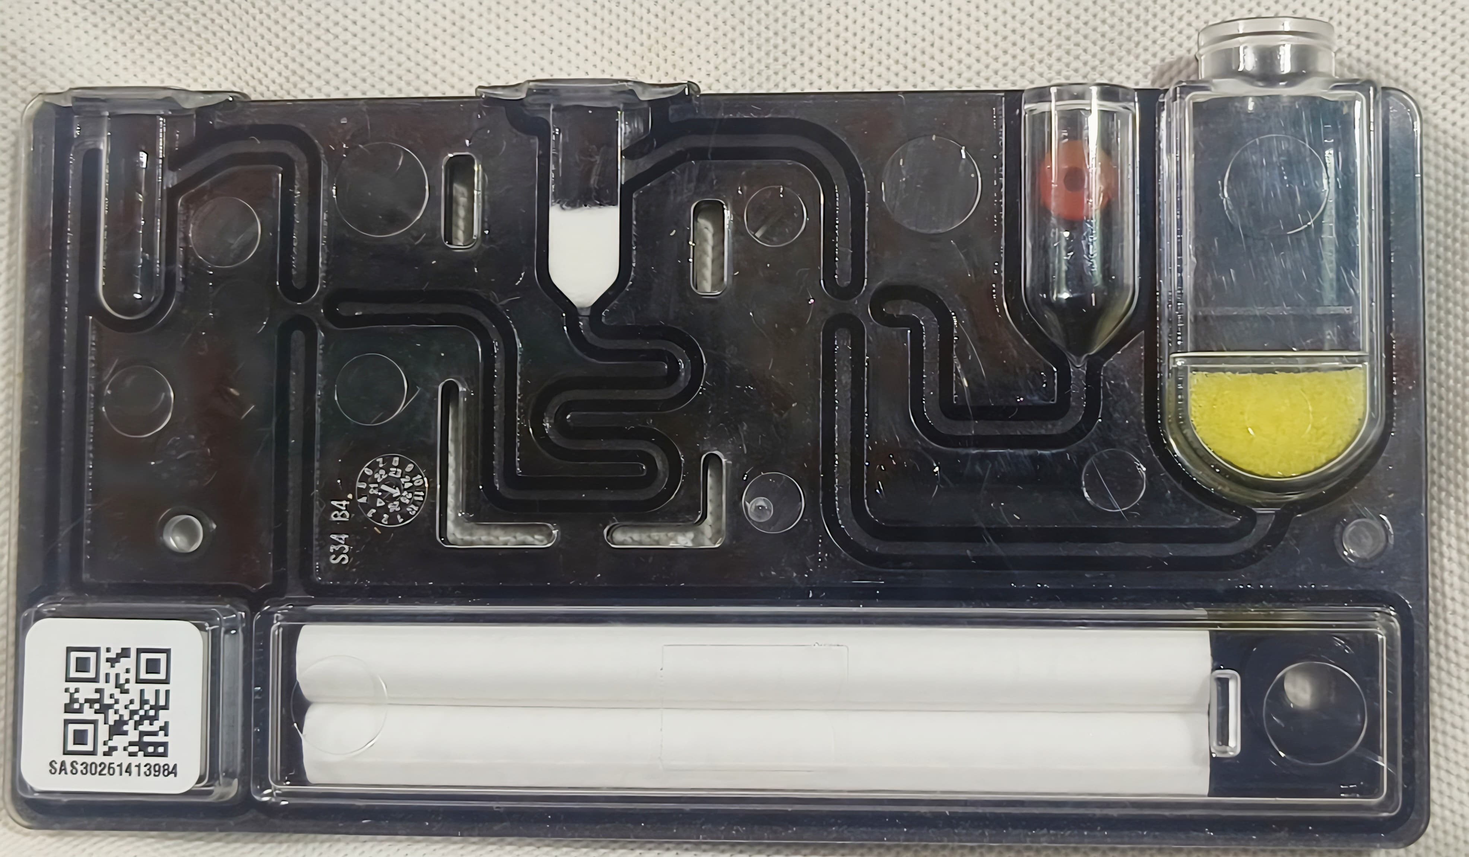
WHAT IS A CARTRIDGE?
This cartridge appears to be part of a diagnostic or testing device. Its design suggests it plays a role in fluid or sample processing, likely for medical or scientific applications. The overall structure suggests it enables controlled movement of fluids and possibly chemical reactions, making it a crucial part of a diagnostic tool.

Slide 7
KEY FEATURES:
QR Code: The code labeled "SA: 508621419804" suggests it can be scanned for information or tracking.
White Cylindrical Objects: Likely components used in sample processing or filtration.
Maze-like Pathway: Could be guiding fluids or samples through a predefined process.
Circular Section with Red Dot: Might indicate a reaction or test result.
Transparent Area with Yellow Substance: Could be a reagent or processed sample.

Slide 8
FINAL INSPECTION PROCEDURE:
The final inspection procedure includes:
Visual inspection for surface defects, discoloration, or deformities.
Dimensional checks using precision instruments like calipers and gauges.
Documentation of inspection results and batch traceability.

Slide 9
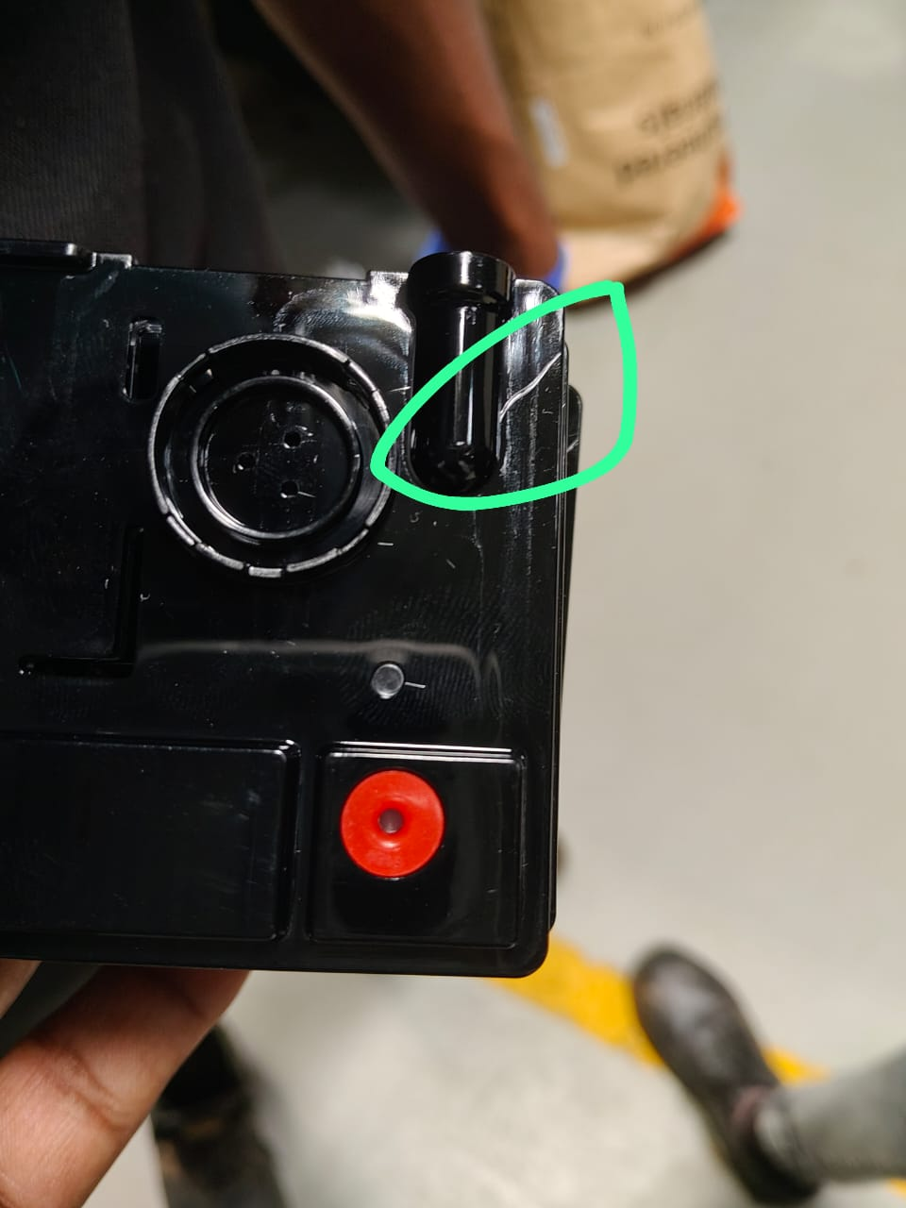
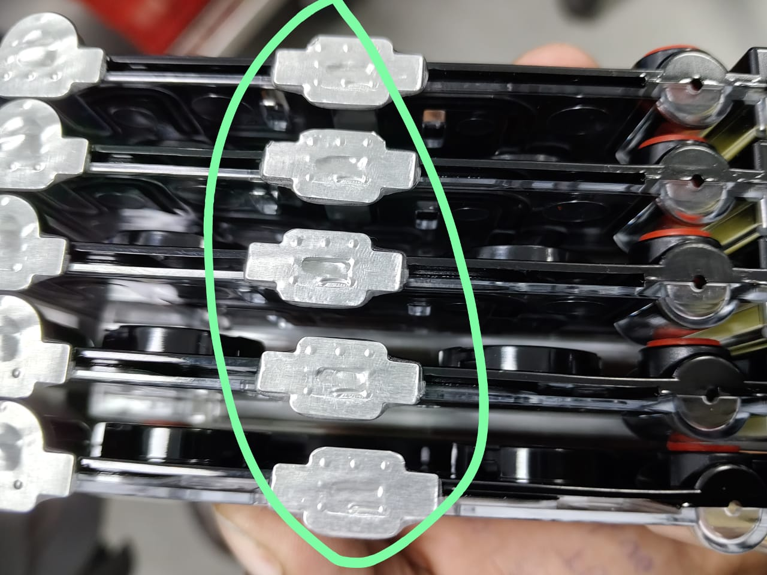
Physical Defects:
Cracks or damage to the casing.
Misalignment of components.
Improper sealing or leakage.

Slide 10
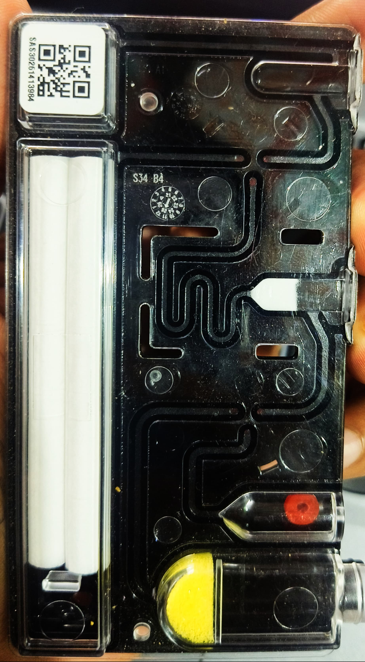
2.Functional Failures:
Inconsistent fluid flow or blockage in pathways.
QR code unreadable or incorrect labeling.
Failure in chemical reaction or sample Processing.

Slide 11
3.Contamination Issues:
Presence of foreign particles or dust.
Improper sterilization (if used in medical applications).
Discoloration or unexpected chemical reactions.

Slide 12
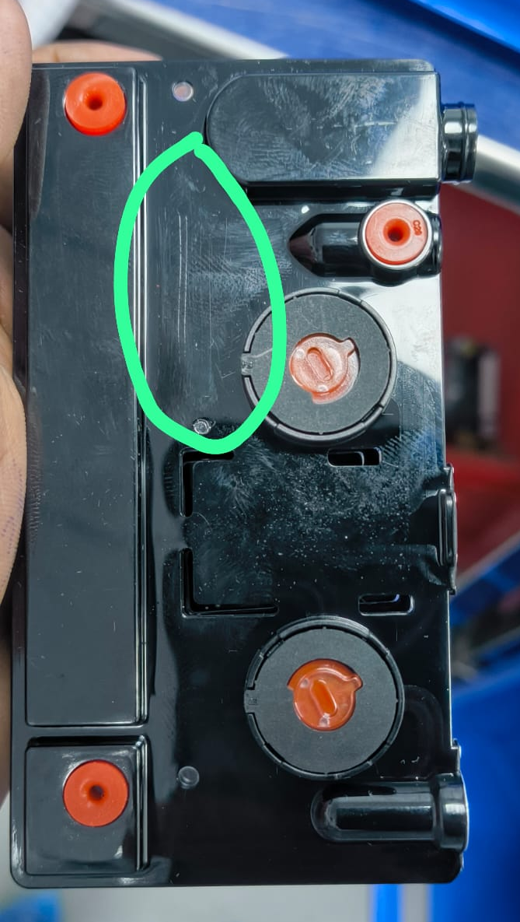
4.Manufacturing Errors:
Incorrect assembly of internal components.
Defective materials affecting performance.
Non-compliance with industry standards.
FQC typically follows Acceptance Quality Limit (AQL) standards, where defects are categorized as critical, major, or minor. If a cartridge fails inspection, it may be reworked, scrapped, or sent for further analysis depending on the severity of the issue.

Slide 13
TOOLS AND EQUIPMENT USED
The tools used during the inspection include:
Magnifying lens to detect minor rejections.
Scanning machine to scan the product.
Inspection Sheets: for recording measurements.
PPE: Safety gear to protect inspectors from hazards.

Slide 14
CHALLENGES FACED
Several challenges arise during inspection:
Identifying fine cracks or subtle defects.
Managing the high volume of parts within limited time.
Maintaining focus to avoid human error.
Recording and tracking defect data efficiently.

Slide 15
LEARNINGS AND SKILLS GAINED
During the internship, the following skills and experiences were gained:
Enhanced attention to detail and observational accuracy.
Knowledge of quality assurance methodologies.
Hands-on experience with industrial inspection tools.
Improved communication and teamwork in a production setting.

Slide 16
CONCLUSION
The internship provided valuable exposure to industrial inspection and quality control. It highlighted the critical role of final inspection in ensuring product reliability and safety. The experience supports long-term goals of working in manufacturing or quality assurance roles.

Slide 17

Thank you

